Slide 1
Access Control

Slide 2
Recap of Week 6
Weak authentication vs. strong authentication
Password authentication:
  How it works: Server uses the password to encrypt a public message (or compute a hash digest) and compares it against the password file entry.
  Password cracking: online vs offline; dictionary vs bruteforce
  Replay attack: applicable to all weak authentication schemes.
Strong authentication:
  Challenge-response protocol
  Time-stamp protocol
Identity Management & Open ID

Slide 3
Overview
Content
  Introduction
  Access control models
  Discretionary access control (DAC)
    Security problem of DAC
  Mandatory access control (MAC)
  Role based access control (RBAC)
After this module, you should be able to
  Describe what access control is
  Describe how computers and service providers use different kinds of access control to protect resources

Slide 4
Access Control Overview
Motivation
  Multiple users share information resources
Access control
  Who can access what and do what operation.
  Authorization follows authentication.
Examples:
  when you login to eLearn, you have different rights for different content.
  Windows does not allow non-Administrator users to write to C:\
  You may specify access rights on who can view or comment on your photos or blogs in OSN.
  Android/iOS permission policy
Notes:
Access Control determines allowing of usage of some application and denying the usage of some applications.

Slide 5
Three Models
Discretionary Access Control (DAC): the access rights are at the discretion of the resource owner.
Mandatory Access Control (MAC): the access rights are mandatorily defined based on certain policies, not at one's discretion.
Role-Based Access Control (RBAC): the access rights are defined according to the users' roles.
  In general, an access control model involves three elements: subject, objects, rights.
Notes:
DAC and MAC usually used in DB/OS etc
RBAC usually used in application layer.
DAC – the owner decides who can access what.
Each Object has an owner. OS will enforce what the user says.
Owner is the biggest. – user can just allow other people stuff (leak whole system and compromise.)
For DAC, say if I own the object, I am the biggest shit, I can say you use this etc.
MAC – System decides on who can access what.
Each subject/object has security labels (Top Secret, Confidential etc) – hard to manage for normal users
RBAC – Decided based on roles
Eg Admin, Teacher etc.

Slide 6
Authentication vs Access Control
Initially, the system must first determine who is the one requesting access accurately
In addition, the system must also specify what actions can the subject do on those objects
The process of accurately determining the subject’s identity is called authentication
Restricting access of objects to ONLY those subjects authorized is called access control

Slide 7



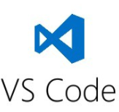


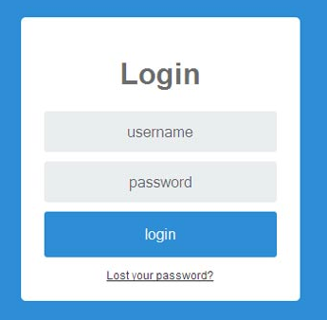





User
Principals
Subjects
Objects
Dean
Faculty
Access rights:
read, write, execute, …
Staff
The process of accurately determining the subject’s identity is called authentication
The process of specifying and controlling who (which subjects) can access what (which objects) and how (by which means) is called access control
Notes:
Subject might be an object/ object might be subject
Subject will use the object

Slide 8
Discretionary Access Control (DAC)

Slide 9
Who is “Who” ?
Access control deals with programs running on behalf users.
Browser
faculty
SAP
(Prof. Pang)
user
Browser
SCIS Dean
principals
subjects
Notes:
You can log in to your computer as Administrator or a normal user or a guest. So, the same user, yourself, corresponds to three principals (admin, regular user, guest). therefore, the same program you run in different login session should have different privilege. That’s the reason some software installation requires you to login as Admin.
You can take on multiple roles (multiple principals), you can access the same subjects as different principals but also, be granted with different access.

Slide 10
User - Principals
One to many mapping between user and principals
System authenticates user in the context of principal
Shared principals (accounts) are not good for accountability
Alice.Top-secret
Alice
Alice.Secret
Bob.Dean
Bob
Bob.Faculty
Bob.Super-user
user
principals
Notes:
User can take on many roles.
When you have shared principals, you wont know who is using what.

Slide 11
Principal - Subjects
One to many mapping between principal and subjects
A subject is a program or application run on behalf of principal
If all subjects of a principal have the same rights, they are often treated the same as principal
Email
Alice
Word
principal
Database
subjects
Notes:
A user with a role can take on multiple subjects.
Subject is run on behalf of principal.
DAC is where the subject inherits the access rights of the user.
User to principal – authenticate the user based on the context of the principal
Principal to Subject – Subject carry out operations on behalf of the principal, one to many mapping, if all subject have same access right as principal, usually detreated the same as principal.

Slide 12
Objects
An object is anything on which a subject can perform operations (mediated by rights)
Usually objects are passive, for example
  File
  Directory (or Folder)
  Memory segment
But, subjects can also be objects, with operations
  Kill
  Suspend
  Resume
Notes:
Objects are just items that the subjects use to act on.
They are things like files, directory, memory segments. They get slutted upon basically.
Subjects (the intermeditary) can become the thing that is being acted on. For example, another subject can become an object. Chrome (usually the one accessing files), can be killed (killing via task manager is your subject now).

Slide 13
Rights
A Right specifies what kind of access a subject can perform on an object. Typical rights include:
  Own
  Read
  Write
  Execute
  Create
  Delete
  Transfer
  ….
This list is dependent on the nature of the objects and the applications
Notes:
In DAC systems, these rights that these subjects has on objects are inherited from the principal. The principal will have rights defined like can write, can execute, can read etc. Then the subject can use these and act upon them.

Slide 14
Logical Representation of DAC Policy
objects
F
G
U
orw
subjects
rights
V
r
orw
o – own r – read w – write
Logically, DAC can be represented as a matrix!

Slide 15
Two Types of Implementation
Design Issues: where to store, in which form, and how to enforce
ACL
objects
F
G
subjects
U
orw
Capability
rights
V
r
orw
Notes:
Can come in the form of a linked list for f.
U is the first item, which has orw
V is the second item, which has r.
Capabilities vs ACL
Capabilities is stored with SUBJECTS. Essentially, a subject would have a list of for example object a:r, object b a:w object c:x. It is important for the capabilities to not be forgeable as this poses a security risk.
When someone wants to access the files, the subject, it would check the user’s principal (identity) and the access right.
ACL is stored with the OBJECTS. Essentially, an object would have a list of subjects and their corresponding rights. Like, Object O has a list of entries like (Subject A:blah etc)

Slide 16
Access Control List (ACL)
ACL – Each column of access control matrix is stored with corresponding objects.
ACL requires subjects to be authenticated before making the decision.
F
G
File
Pointer
Access right
User
U:o
U:r
U:w
V:r
V:o
V:r
V:w
F
U
orw
G
V
r
V
orw
Notes:
This is essentially a linked list.
The File F has the following permissions: U:o, U;r, U:w, V:r – Going based on objects (F and G is the object ).
Two ways, F can have a Pointer in which points to a whole list of of the ACL (U: orw etc)
Or it can go another way, where the File maintains a list of its permissions like u:o etc.
U AND V ARE SUBJECTS.

Slide 17
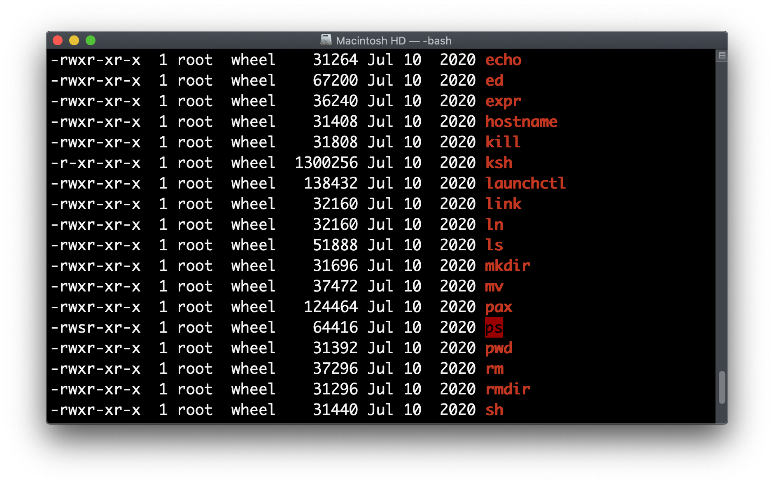
Examples of ACL
File system in OS

Slide 18
Case Study of ACL: UNIX File System
Given a file/directory (object), 3 permissions are set on/off for 3 types of users by its owner
  user/owner group others (world users)
  r w x r w x r w x
ls -l file1
-rwx--x--x 2 Alice staff 2048 Jan 1 12:10 file1
ls -l dir1
drwxr-xr-x 3 Alice user 1024 Jan 1 09:27 dir1
Non-Examinable

Slide 19
Example: ACL commands
rwx rwx r--
111 111 100
7 7 4
Command: chmod 774 file1
mode may also be specified symbolically as +r which would add read permissions to everyone
chmod g+r file1
  Add read permission to group regarding file1
chmod go+w phone.numbers
which means “group others add write”
The general syntax, using the conventional method:
chmod [ugo]+-[rwx] filename(s)
rwx rwx rwx
110 100 000 = 640
Non-Examinable

Slide 20
Capabilities
Capabilities – Each row of access control matrix is stored with the corresponding subject.
  i.e., a capability is a token held by the user to specify the user’s access rights in the system.
Capabilities require:
  They are unforgeable
  Propagation of capabilities are under control
U
F/o, F/r, F/w
V
F/r, G/o, G/r, G/w
Notes:
Capabilities – something that your subject holds.
You can think of it as something like a key that the subject has.
Without capabilities, the subject has no access to the object.
For example, google chrome has permissions to read to files, but not write to files.
Unforgeable – cannot be created by subject randomly. Control propagation means the subject can only to a certain extent, pass the capabilities to other subjects.

Slide 21
Comparison of ACL and Capabilities
ACL
  Access rights stored with objects
  Requires authentication of subjects
  Provides access review on a per-object basis
  Most operating systems such as UNIX and Windows use ACL to protect files
Capabilities
  Access rights stored with subjects
  Requires unforgeability and control of propagation of capabilities
  Lays ground work for Kerberos (a well-known authorization system)
Notes:
ACL is attached to object; a file. – A object
Capabilities is attached to a subject. – Chrome can access something?
ACL – a object has a list of who can access me like userA:rwx userb:wx etc.
Since stored with object, I will check its authentication (can you use).
Capabilities – stored with subject, in which has fileA:rwx etc.
Since stored with subject, it cannot be forged and control of propagation of capabilities.
For ACL, there is a access review on object basis.

Slide 22
Summary of DAC
DAC
  Access control is based on an access matrix
  Allows propagation of access rights from one subject to another
    The owner of an object has full control over the propagation of access rights for the object
    Can have propagation. But it should be controlled.
  Used in a wide variety of implementations (in commercial and industry)

Slide 23
Mandatory Access Control (MAC)

Slide 24
Security Problems of DAC (1)
Access control policies in DAC are defined according to the owner’s discretion without rigorous security checking.
  It may have security loopholes leading to trojan horse attack that leaks confidential information.
ACL
r
U:r U:w
(CFO)
Principal U
File F
w
w
r
U:w V:r
(Manager)
Principal V
File G
Suppose that Principal V is a bad guy who wants to read file F
Notes:
DAC is weak because of this reason.
Imagine I have RW access to file F, and W to G
And person J have R access to G.
I can just take what I have from F, and write to G. If G is bad, im cooked.

Slide 25
Security Problems of DAC (2)
Principal V sends U a benign software with Trojan horse embedded
U executes the software → Trojan horse has U’s privileges
ACL
exe
r
U:r U:w
Principal U
File F
Trojan horse
Benign software
w
r
U:w V:r
Principal V
File G
Principal V can read file F with the help of Trojan horse!!
Notes:
What is a Trojan Horse – when you execute, it’s a malicious program which can take on your identity and your permissions (rights) to certain objects and conduct operations on them.
For DAC, I can just run a trojan horse which takes the rights someone has to something, and run certain processes on it to exploit him.

Slide 26
Mandatory Access Control (MAC)
Basic Idea: to enforce information flows so that they strictly follow only those paths satisfying the predefined policies.
MAC uses security labels attached to subjects and objects and define policies according to labels.
  The labels allow objects/subjects to form a hierarchy.
  Policies are defined upon information flow directions in the hierarchy.
Users cannot create/modify security labels which are assigned by Admin only.
Notes:
Even if I am the owner of file, this one is given by the system.
Security labels are used to attach to subject and object.
For subjects, it is clearance. For objects, it is sensitivity.
So if for example, if my subject has access to secret data, I can only READ anything that is below or at same level as secret (for objects)
But, if as the subject, I can access write to things that are higher to me ”Secret can write to top secret”
The principal will give the subject the permission. Subject inherit from principal. From there, the subject will be able to read downwards, write upwards.
It is the same from principal to subject as well.

Slide 27
Hierarchy Defined Based on Labels
Use Security classes
Use category sets
  Set A is inferior to Set B if A⊂ B
Top secret
{Defense,WMD,Terrorist}
Secret
{Defense,WMD}
{Defense,Terrorist}
{WMD,Terrorist}
Confidential
{Defense}
{Weapon.M.D.}
{Terrorist}
Unclassified
{}
There is an order among labels. It’s a total order if any two labels are comparable; otherwise, it is partial order.
Notes:
If your label is top secret, you can read a file with secret.

Slide 28
BLP Model
Bell and LaPadula model (BLP)
  A formal MAC model which lays out the rules for concrete access policies based on security labels.
  Define allowable information flows in order to maintain data secrecy.
  Does not address integrity.
  Key part in US DoD security evaluation criteria.
Notes:
Addresses confidentially, not integrity. Because you can only prevent who to access.
Prevent data from FLOWING to high level to low level.
Data can FLOWING from low level to high level (can report from low to high, cannot report high to low)
Data can only flow downwards, but you can give it upwards.

Slide 29
BLP Model (1): Two MAC Rules
Simple-security property (read-down)
  Subject S can read object O only if label(O) is lower than or the same as label(S).
Star-property (write-up)
  Subject S can write object O only if label(O) is higher than or the same as label(S).
Read down
Label(S)
high
allowed
Label(O)
low
Write up
Label(O)
high
allowed
Label(S)
low
Notes:
Can only read with object is lower or same level higher.
Can only write to object with same or higher level – take it as you are a small one. You can add info basically.

Slide 30
BLP Model (2)
Note
  ACL: AC decisions are made based on principals
  ACL + BLP: AC decisions are made based on principals + security labels of subjects and objects
  Star-property prevents information leakage caused by Trojan horses.
    Why – see next slide
Notes:
With both together, we can check if whether this person is secret matches my subject’s property.

Slide 31
BLP Model (3)
DAC:
MAC with BLP:
exe
r
U:r U:w
Principal U
File F
Trojan horse
Benign software
w
r
U:w V:r
Principal V
File G
exe
r
U:r U:w
Principal U
File F
Trojan horse
(Label H)
w
Benign software
star-proprety
r
U:w V:r
(Label L)
Principal V
File G
Notes:
MAC with BLP has another layer. Basically, If you have a trojan horse in which with different label, you cannot anyhow access with the wrong security labels.
File F has ACL, File G has ACL.
Owner of the resource can define these. Root user/Admin can also.
DAC cannot prevent potential attacks of bypass.
Trojan horse take principal U and has its permissions and can read/write F or G.
BLP is for confidentiality, not integrity.
Label is pasted on Principal and the Subject/Object.
So principal can access them, or even lower.
Read Down, Write Up.
Star Property -> you cannot write up.
If say for intergirty, you cannot write up. You can modify non important (write down maybe?) but cannot write up.
BLP is ONLY FOR CONFIDENTIALITY

Slide 32
Downsides of MAC
Why MAC is not appropriate for some commercial use?
  MAC was originally developed for military use
    Hierarchical structures: top secret, secret, confidential, unclassified
  There are significant differences between commercial and military information security
    Data items (objects) may have different degrees of sensitivity: public, proprietary, internal
    No formalized notion of clearances (subjects) → no dominance (can-flow) function → access is less regulated
Notes:
This is not good because it is too restrictive, collaboration between parties will be difficult.
Everyone can define whatever ways they want, and it is not very helpful when some information is defined differently between different parties.
For BLP, you need to have classification of each documents to prevent a breakdown of definition. Documents MUST BE well-defined.
DAC and MAC is mainly used for file system, OS and database.
Like S3 Buckets.
You can use DAC/MAC on the server hosted on maybe elearn.
RBAC is more fine-grained, where one person can do this etc.

Slide 33
Role-Based Access Control (RBAC)

Slide 34
Role Based Access Control (RBAC)
A general access control model for management of security in companies and organizations
  General, flexible and easy-to-use
    Addresses many different security needs in commercial and government sectors with minimal customization
    Maps naturally to organization’s structure
  Support at application level (SQL, Oracle, Web Applications, …)
Notes:
Mainly used for application layer operations.
Y

Slide 35
Terminology
User: An individual that has access to the system.
Role: A named job function within the organization the controls the system.
Permission: An approval of a particular mode of access to one or more objects.
Session: A mapping between a user and an activated subset of set of roles to which the user is assigned.

Slide 36
Role
Role can represent users in terms of
  Specific tack competency such as physician and pharmacist
  Job responsibility as of project supervisor
  Specific duty assignment such as duty physician or shift manager
Role also defines permissions
  Operator role can access all files but cannot change access permissions
  Security officer role can change access permissions but has no access
  Auditor role can only access audit trails
user
UA: user assignment
role
PA: permission assignment
permission
Sessions (one-to-many mapping)
Notes:
Role can be seen as a special instantiation of the principal.
Can have a hierarchal structure.
Role can be like your user role, role define your permission.
There is inheritance. As parent can use everything under children.
Eg, CEO can have CTO permissions.
CTO can have SVP permissions
SVP can have VP ones.

Slide 37



A Banking Example
Functions and Official Positions
Alice
Role | Function | Official Position
A | financial analyst | Clerk
B | financial analyst | Manager
C | support e-commerce | Junior
Eve
Permission Assignments
Role | Application | Access Right
A | money market instruments | 1,2,3,4
 | derivatives trading | 1,2,3,7,10,12
B | money market instruments | 1,2,3,4,7,
 | derivatives trading | 1,2,3,7,10,12
 | interest instruments | 1,4,8,12,14
… | … | …
Bob
Notes:
You don’t need to care who the user is, Just log in as a particular role.
Role decides your permissions. – Kinda decided by the SysAdmin.
For DAC, owner/sysadmin decides your permission on the files etc. – Common in OS.

Slide 38
Flexible Security Management
Security management is simpler with RBAC
  User-role relationship changes over time
  Role-permission relationship is relatively stable
  Security management based on roles rather than permissions is simpler.
dynamic
stable
user
UA: user assignment
role
PA: permission assignment
permission
Sessions (one-to-many mapping)
Notes:
Role to permission is stable : not always changed.
User to role: dynamic cos user roles might change here and there.

Slide 39
Take Away
Access Control: Limiting who can access what in what ways
DAC: Widely used; the owner of an object has full control over the propagation of access rights for the object – resource owner like Linux.
MAC: augments DAC using security labels attached to subjects and objects; suitable for information systems where there is a formalized notion of security clearances – labels on items based on user and subject labels.
RBAC: A general access control model for management of security in companies and organizations; flexible and easy to use – based on user’s roles.

